Slide 1

Project: Contact System
Course: data structures
Group Members:
Sarmed AHMED USMANI
Syed Bilal fahim
Syed Nameer Ali
Instructor: Dr. Quratulain Nizamuddin Rajput

Slide 2
Features
Manages standard information about the contacts.
Saving, deleting, editing, searching, viewing of contacts and displaying them on contact list.
Contact Picture can also be saved.
JavaFX was used in making of the GUI.
Uses filing to store the data.
Is used in Business and different elite express communities e.g., Bitrix24, ProsperWorks and pobuca.
For controlling and handling data with security and ease of access.

Slide 3
Reasons For Choosing Linked list
Easy addition, deletion and viewing of contacts.
Smooth editing in existing contact.
Resizable at run time.
Methods can be implemented iteratively.
Searching of the list was cumbersome but accurate.

Slide 4
Design To Store Data
Contact list: 1 2 3 and so on
Data next
Data next
Data next
Contacts class:
Name
Number
Address
Email
Organization etc.

Slide 5
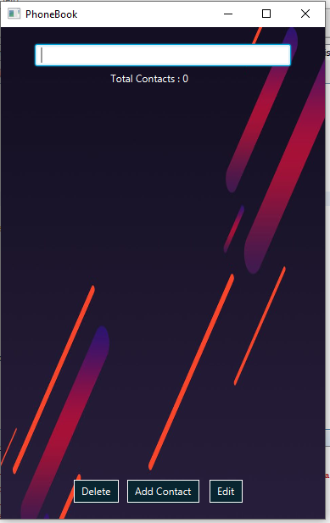
Project Working
It starts with a GUI of an empty contact list with a search bar and buttons of delete, add and edit contacts.
If a delete button is clicked a method in linked list class named as removenode() is used the remove the highlighted contact from the list.

Slide 6
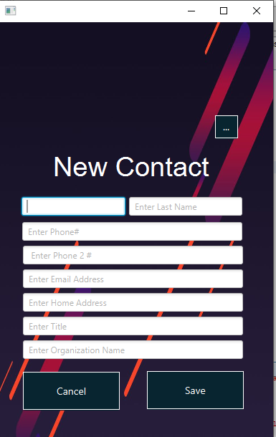
Project Working
After clicking on the add contact it takes us to the new GUI where we can fill up the information of the contact.
The contact’s name will be displayed on the contact list.

Slide 7
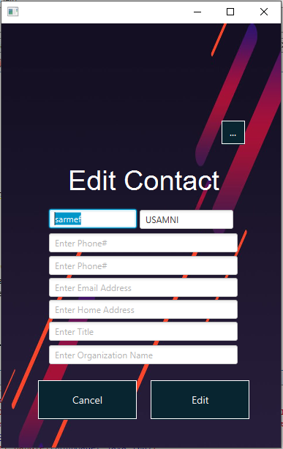
Project Working
After clicking on the edit button, it takes us to the new GUI where we can edit the existing information of the saved contact.

Slide 8
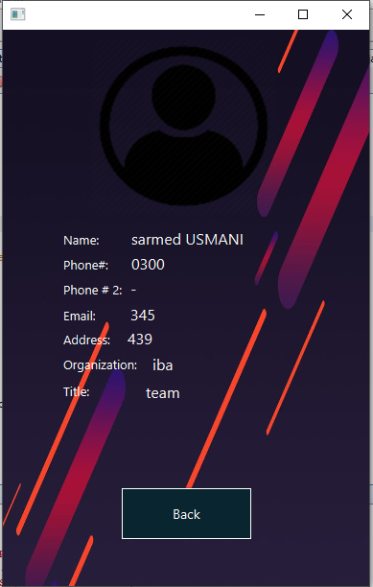
Project Working
To only view the contact, we will double click on the contact displayed on the contact list.
After double clicking, we will be forwarded to the new gui where all information is shown.

Slide 9
Big O Analysis
Linked list class method | Big-O
removenode | O(n)
searchnode | O(n)
searchnodeedit | O(n)
Returnnode | O(n)
length | O(1)
addsorted | O(n)
readlinkedlist() | O(n^2)
writelinkedlist() | O(n)
removeDuplicates() | O(n^2)

Slide 10
JavaFX Controllers
Newcontact Class
Contactmain Class
Addcontactlinkedlist() method for storing input data in variables.
Clearfeilds() for clearing all textarea.
Addchangesscene() for displaying message for contact saving.
Cancelnewcontact() for going to contactmain UI.
Addnewcontact() for displaying newcontact UI.
Totalcontact() for totalcontacts count display.
Searchcontact() searching algorithm for searching contact through contact list.
Initialize methods for handling clicks prompt actions

Slide 11
JavaFX Controllers
editcontact Class
Contactview Class
setInfo() method for again storing the contact information.
canceledit() for canceling the editing process and staying with preexisting information.
setInfo() method for displaying info on the new gui.
imagev() for displaying image of the contact on the gui.

Slide 12
References
JavaFx File chooser for image: http://java-buddy.blogspot.com/2013/01/use-javafx-filechooser-to-open-image.html
Double Click listener for listView: https://stackoverflow.com/questions/22542015/how-to-add-a-mouse-doubleclick-event-listener-to-the-cells-of-a-listview-in-java
Communities references given above: https://www.slideshare.net/romie1995/contact-management-system-phone-book-management-system on slide 15.

